Slide 1
BUSQOM 1080 Data Processing II
Fall 2020
Lecture 18
Professor: Michael Hamilton

Slide 2
Lecture Summary
Today: Data Processing and PCA
Introduction to Markdown [5 Mins]
Data dimension reduction via PCA [20 Mins]

Slide 3
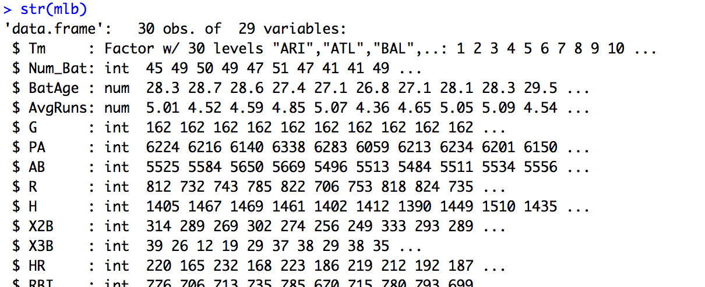
Data for lecture
Save mlb.txt in your working directory
mlb = read.table("mlb.txt", sep = "\t", header = T)
Lots of strongly correlated variables

Slide 4
Markdown Basics
Markdown: Is a language like html that allows you generate beautiful R notebooks (and many other types of documents!).
Pretty much anything you might want to do in word, you can recreate in markdown with a bit of searching including: different fonts, text styling, indentation, layout management etc.
A basic understanding of markdown will allow you to take the sorts of notebooks we’ve made in this class, and turn into presentable reports!
Basics of R Markdown: See https://r4ds.had.co.nz/r-markdown.html
We will demo some of these features in the Zoom session

Slide 5
Markdown Basics
Text Tricks:
# controls header levels i.e:
# Header makes Header
## Header makes Header
*text* does italics
**text** does bold
More on the canvas page!
Putting your notebooks together using “knitr”
When you knit a document it runs all your code and text processing and generated a document you can see in your environment.
To do this just click Knit in the dropdown menu at the top of RStudio

Slide 6
Topic: Principal Components
Problem: Sometimes we have data with lots of features, many of which are redundant (i.e. encode the same information). We called this multicollinearity and noted that they can cause some problems with our regression (making our analysis difficult).
More generally, having many features can degrade the quality of your analysis methods and make them to hard to run. This is related to what’s popularly called The Curse of Dimensionality
Goal: Can we come up with a way to take a dataset with a bunch of redundant features, and compress it into a smaller set of features containing most of the “structure” that it had before?

Slide 7
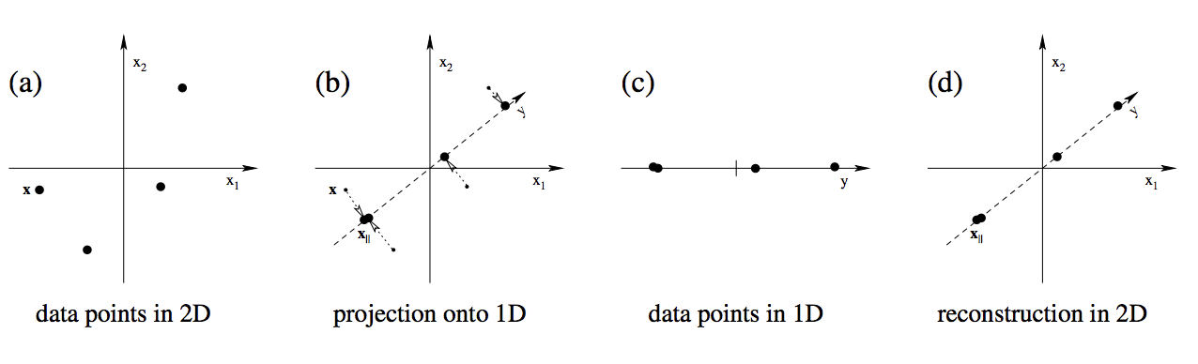
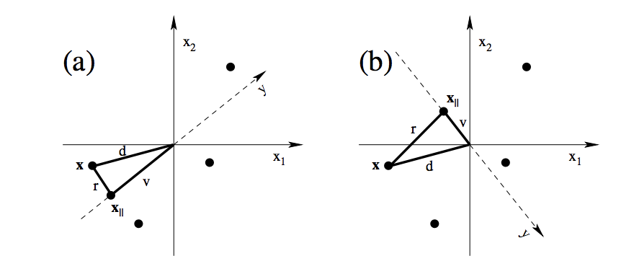
Principal Components Idea
PCA is a beautiful method from linear algebra that shows us how to compress many numeric features into smaller sets of “index’s” that contain most of the datasets structure.
Call first component v₁ = (a,b), the data is written as x’*v₁
Data (x,y) is written as x*(1,0) + y*(0,1)
“Projection” along this line leads to low variance
“Projection” along this line leads to higher variance

Slide 8
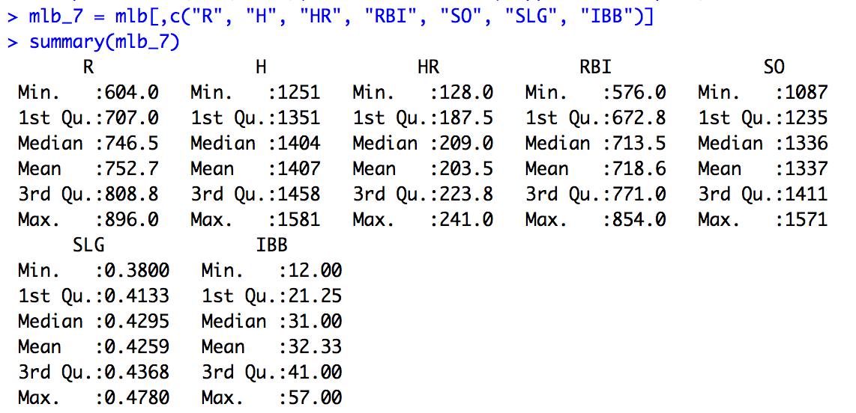
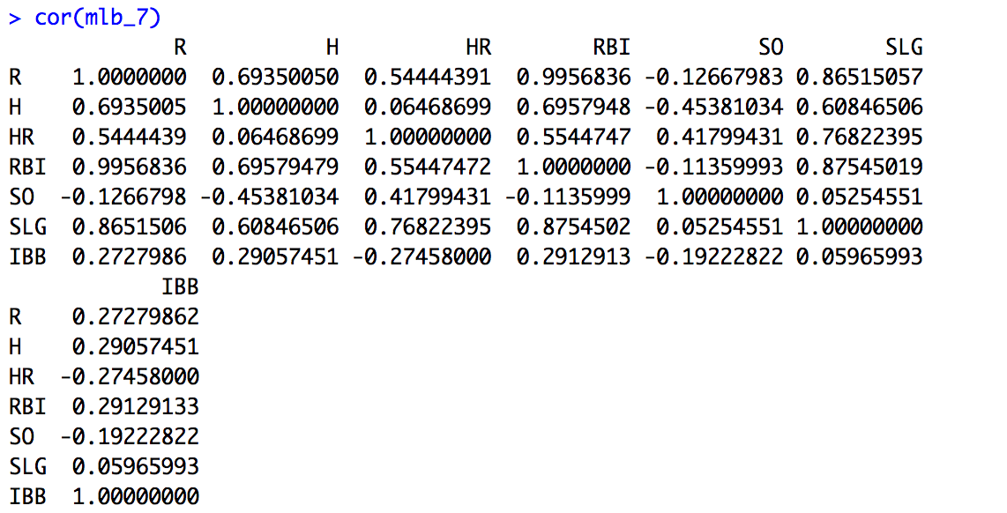
Example: Look at seven numeric features
In mlb look at runs, hits, HR’s, RBI’s, SO’s, SLG, and IBB’s
First, look at summary statistics and correlations:

Slide 9
A better way to view correlations
install.packages(“corrplot”)
library(corrplot)
corrplot.mixed(cor(mlb_7), lower = "number", upper = "ellipse")
Correlation matrix that you want to plot
Show numeric correlation coefficients in the lower triangle
Plot correlation coefficients as ellipses in the upper triangle

Slide 10
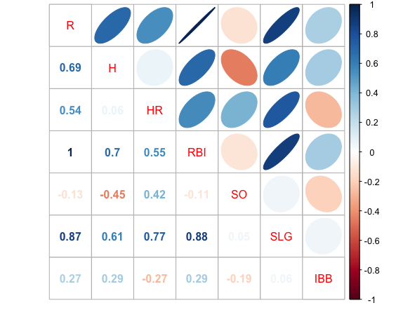
> corrplot.mixed(cor(mlb_7), lower = "number", upper = "ellipse")
Almost no correlation between SO’s and Runs
Strong positive correlation between RBI and SLG

Slide 11
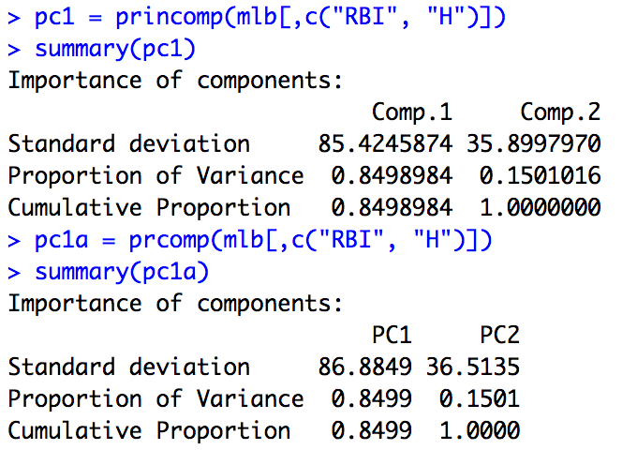
PCA Example: Two Variables
RBI & H: correlation = 0.7
Thus the two features are highly positively correlated
Can we represent both RBI’s and H’s with just a single value instead?
Use principal components:
princomp()
Two functions that do the same thing:
prcomp()

Slide 12
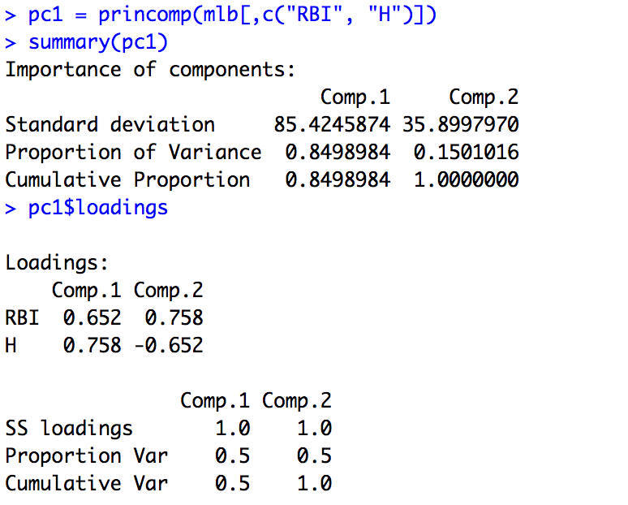
Understanding Principal Components
Identify numeric variables for which you want to compute principal components
This tells us that:
the first component accounts for 85% of the variance in RBI and H
The second component accounts for the remaining 15%
This explains exactly what each component is:
Comp 1 = 0.652*RBI + 0.758*H
Comp 2 = 0.758*RBI - 0.652*H
Comp 1 & Comp 2 are uncorrelated (orthogonal)

Slide 13
Understanding Principal Components
What does this mean? Instead of expressing that data as two columns, one columns is Hits and one column is RBI’s, we can instead express the data as two columns.
The first component is generated by the formula 0.652*RBI + 0.758*H
The second component is generated by the formula 0.758*RBI - 0.652*H.
By algebra you can go back and forth between these two representations (trust me here!).
Why did we do this? The single column of numbers 0.652*RBI + 0.758*H captures almost all of the information as two columns of Hits and Runs.
This is similar to how the S&P 500 works. It’s one number that is explaining most of what’s going on with 500 very correlated stocks!

Slide 14
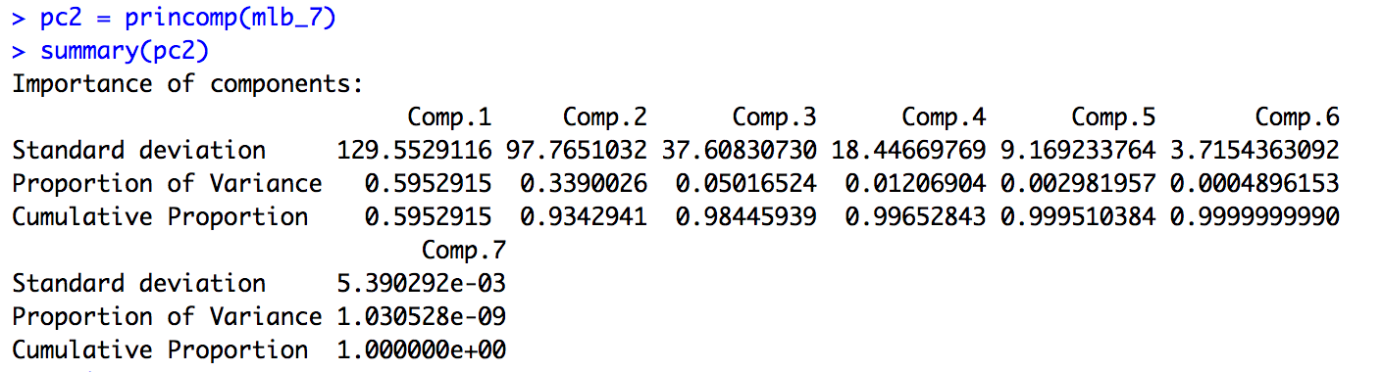
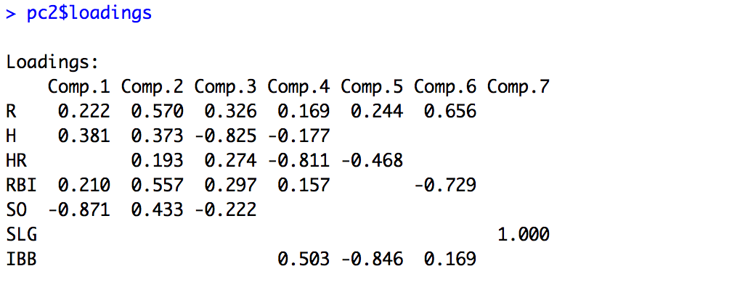
Example: Look at seven numeric features

Slide 15
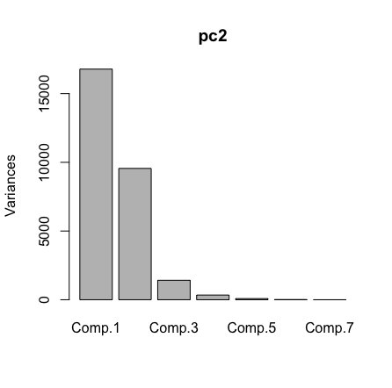
Deciding how many components to use
Use a scree plot, lists components in order of variance
plot(pc2)
In this case, we can reduce the dimension from 7 variables to 3 variables by using principal components
These 3 components capture ~99% of the variance

Slide 16
Technical Details of Principal Components
Slide Disclaimer: We don’t care too much about the math behind PCA in this class, but the following language may useful if you’ve heard a little about PCA before.
The components that PCA returns are just a new way to express the data. They are ranked from most ”expressive” to least.
Coefficients are normalized so that the sum of their squares equals 1, i.e. the new basis is orthonormal
This ensures that the variance of a given principal component can be interpreted as the percentage of the total variance
Coefficients for successive principal components are constrained by the requirement that the variables be uncorrelated with previous components

Slide 17
How should we use PCA results?
PCA makes a new set of features using linear combinations of the old features. It essentially re-expresses the data.
Downside: The new set of features isn’t intuitive, they don’t have nice names like H’s or RBI’s. Now they’re algebraic combinations of features
Upside: These features are ranked in order of importance, that usually means you can use just a the top few components and throw the rest away without degrading your data quality
What you throw away are essentially the “redundant” features.
It’s up to you to choose how many components you use! But this way you get control over the size of your data

Slide 18
Potential Issue: PCA is Scale-Sensitive
Problem: When the features are of different magnitudes, PCA can mistake the larger features for more informative (e.g. HR’s are more important that OPS, because one is around 1000 typically and the other is ~1 typically). This is called Scale Sensitivity.
Example: Measuring a variable (Y) in millimeters versus centimeters
Variance of 10Y is 100 times greater when Y is measured in mm instead of cm
Y will be given more weight in PCA when other variables remain unchanged
Solution: Normalize all variables before performing PCA (i.e., subtract means and divide by standard deviation)
The R functions will do this for us!

Slide 19
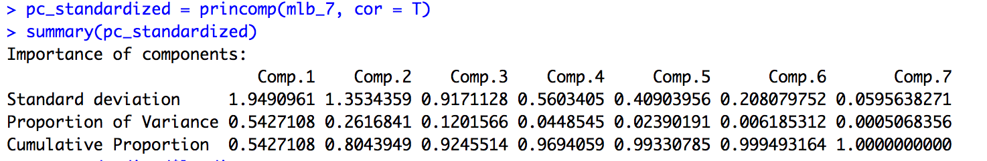
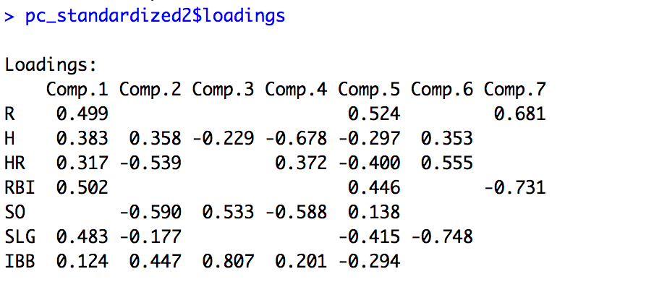
PCA Example with Standardized Values
Standardizes variables first, c.f. prcomp(scale(mlb_7))

Slide 20
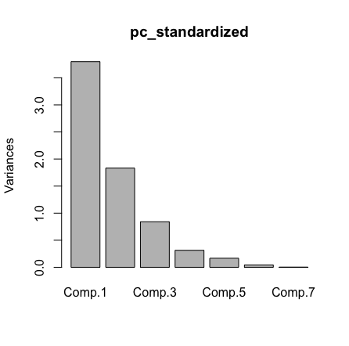
PCA Example with Standardized Values
Before we only need 3 principle components to explain 99% of the variation in the data. After standardizing we now need 4.

Slide 21
PCA Overview
Re-express a set of inter-correlated variables as a smaller number of uncorrelated principal components
Usages:
Reduce the dimension of a multivariate response
Reduce the dimension of a set of explanatory variables
Summarize a single multivariate sample
Powerful preprocessing step for many methods

